Slide 1
Economic Activity Levels
Bellwork:
Write three economic activities in your notes.

Slide 2
Vocabulary
Terms:
Export: Items that are made to be sold outside of the country they are made in.
Import: Items brought in from another countries to be bought.
Economy: How money and goods circulate.

Slide 3
Economic Activity Levels
Economic Activities → any activity that creates a product that can be bought or sold.
Example: Fishing

Slide 4
Four levels of Economic Activity
Countries can have up to four levels of economic activity, BUT not every country has all four.
There are four (4) levels of economic activities:
Primary
Secondary
Tertiary
Quaternary

Slide 5
Economic Activity Levels
Primary Level
Economic activities that use the Earth’s natural resources. (Process of extracting natural resources)
Any country can extract their natural resources.
Examples include farming, fishing, mining, oil drilling, etc.

Slide 6
Economic Activity Levels
Secondary Level
Economic activities that change primary materials into usable consumer products.
Adding value to a natural resources and creating products.
Example: Bottled Water
“Less developed” countries begin to manufacture products from primary industries.
Secondary industries mark an advancing economy in “less developed” countries.
“More developed” countries have a well established industrial base.

Slide 7
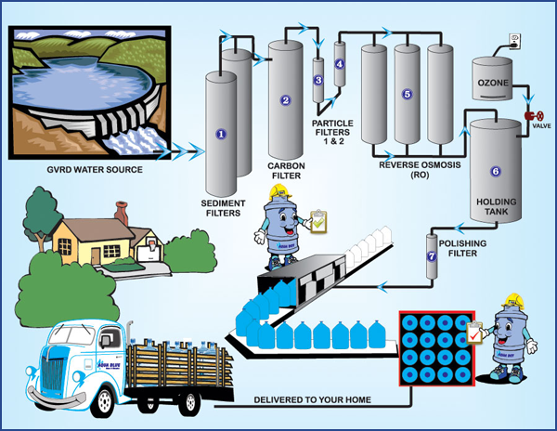
Water Production- Is this a primary or secondary economic activity?

Slide 8
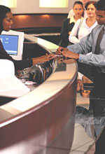
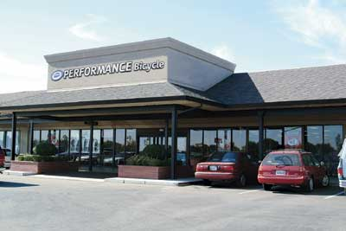
Economic Activity Levels
Tertiary Level
Providing professional services and the services required to distribute the products.
Example: Kroger sells you and I bottled water.
provide services to primary, secondary industries, communities and individual consumers
Found in countries where economies have reached a stage where selling a product or a service is a major part of the economy.
These are generally found in “more developed” economies.

Slide 9
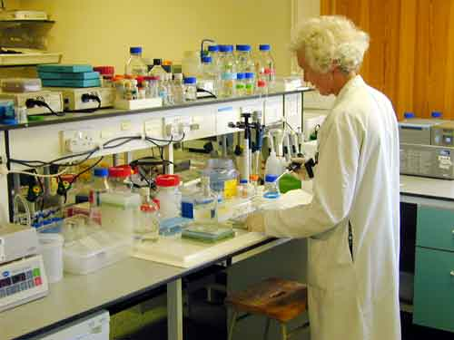
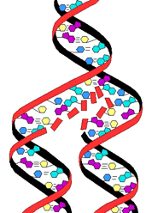
Economic Activity Levels
Quaternary Level
Process of STUDYING product research and improving on its production.
Example: Aquafina uses data from a research lab to increase their products purity.
Economies have reached the technological level.
People are involved in jobs such as information research, management and administration and have a mass consumption of goods and services.
Found in countries with the highest level of economic development

Slide 10
Economic Activity Levels: Pencil
Primary Level
Resources needed to make a pencil:
Wood
Graphite (Lead)
Rubber (Eraser)
Metal
Secondary Level
Quaternary Level
Tertiary Level

Slide 11
Economic Activity Levels: Pencil
Primary Level
Resources needed to make a pencil:
Wood
Graphite (Lead)
Rubber (Eraser)
Metal
Secondary Level
Putting the different resources that make up the pencil together at the factory
Tertiary Level
Quaternary Level

Slide 12
Economic Activity Levels: Pencil
Primary Level
Resources needed to make a pencil:
Wood
Graphite (Lead)
Rubber (Eraser)
Metal
Secondary Level
Putting the different resources that make up the pencil together at the factory
Quaternary Level
Tertiary Level
Selling the pencil to consumers

Slide 13
Economic Activity Levels: Pencil
Primary Level
Natural Resources needed to make a pencil:
Wood
Graphite (Lead)
Rubber (Eraser)
Metal
Secondary Level
Putting the different resources that make up the pencil together at the factory
Quaternary Level
The CEO (leader) of the pencil company
Researching and developing new types of pencils and better ways of making pencils
Tertiary Level
Selling the pencil to consumers

Slide 14
FRONT
PRIMARY | SECONDARY
BACK
TERTIARY | QUATERNARY

Slide 15
Lumberjack
Peanut Farmers
Coal Miners
JIF Peanut Butter
Cheese Processors
Paper Manufacturers
Textile Manufacturing
Diamond Miners
Wheat Growers
Fishermen
Banana Growers
Chicken Farmers
Gasoline Refiners
Motts Juices
Oil Drillers
Cattle Ranchers
Cotton Farmers
Fish Canneries
Frito-Lay
Dairy Farmers
Nestle
Coca-Cola

Slide 16
Electrician
Kroger
Bank of America
Stock Broker
Doctor
Tailor
Teacher
Fitness Instructor
President of GM
Bartender
Veterinarian
Dry Cleaner
School Principal
CEO of Disney
Cancer Researcher
DNA Scientist
Nuclear Physicist
Document Librarian
NASA Researcher
White Collar Workers
Director of Personnel
Pet Store Worker

Slide 17
Does Germany rule your world?

